Slide 1
Overall Sample Size
We must hypothesize:
The percent of households enduring catastrophic costs
We know from previous work it may be around 30%-50%
Precision we are willing to accept
4% precision would lead to a 95% confidence interval of 26%-34% of patients enduring catastrophic costs due to TB.

Slide 2
Cluster Selection
For statistical power, we advise to have (at least) 25 clusters in the survey.
With 1004 patients in total, this leads to about 40 patients per cluster.
Using the list of townships and the number of notified cases in each, we select “clusters” proportional to the number of notifications from last year.
For example Hpa-an has twice the likelihood of being selected as a cluster as Thanbyuzayat.
Region | Township | Total Cases
Mon | Thanbyuzayat | 657
Kayin | Hpa-an | 1303

Slide 3
Cluster Selection (continued)
Region | Township | Total Notifications | Cluster | Patients Interviewed
Magway | Minbu | 307 | 1 | 40
Mandalay | NyaungU | 431 | 2 | 40
Kayin | Myawaddy | 788 | 3 | 40
Naypyitaw | Pyinmana | 515 | 4 | 40
Bago | Oakpo | 505 | 5 | 40
Yangon | Taikkyi | 730 | 6 | 40
Ayeyarwaddy | Hintada | 975 | 7 | 40
Mon | Thanbyuzayat | 657 | 8 | 40
Shan(lashio) | Lashio | 1300 | 9 | 40
Naypyitaw | Tatkone | 335 | 10 | 40
Mandalay | Pyi gyi tagun | 411 | 11 | 40
Yangon | MingalarT'N | 593 | 12 | 40
Yangon | Thonegwa | 265 | 13 | 40
Kachin | Myitkyina | 1861 | 14 | 40
Yangon | Hlaingtharyar | 2159 | 15 | 40
Bago | Daik-U | 463 | 16 | 40
Ayeyarwaddy | Labutta | 524 | 17 | 40
Sagaing | Myaung | 127 | 18 | 40
Ayeyarwaddy | Danubyu | 315 | 19 | 40
Magway | Pakhokku | 679 | 20 | 40
Sagaing | Tamu | 478 | 21 | 40
Chin | Mindat, Mag | 144 | 22 | 40
Kayin | Hpa-an | 1303 | 23 | 40
Shan (Tauggyi) | Namsang | 260 | 24 | 40
Bago | Kyauktaga | 583 | 25 | 40

Slide 4
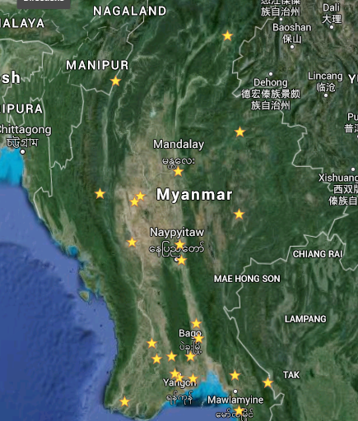
10-11 interviewers each responsible for two to three townships.
Expected 2-3 weeks per township to survey 40 TB patients in each.

Slide 5
Web Survey Tool (https://wxh3d.enketo.org/webform)
Originally used by WHO for Ebola response
Requires:
Laptop or tablet
Modern browser (Chrome, Firefox, or IE 7+)
Network connection (only sometimes)
Burmese language installed
Benefits:
No secondary data entry
Automatically skips to correct next question
Data sent to central repository at WHO

